Slide 1

CONDITIONAL STATEMENTS
PRESENTED BY : HAFSA AFZAL AND AISHA MAHMOOD ( code crakers )

Slide 2
INTRODUCTION
Q: what are conditional statements ?
Conditional statements execute a specific action based on the results of an outcome of true or false.
In javascript we have following conditional statements:
If statement
Else statement
Else if statement
Contiditonal ternary operator
Switch statement

Slide 3


IF STATEMENT
Use the if statement to specify a block of JavaScript code to be executed if a condition is true.
SYNTAX:
if (condition) { // block of code to be executed if the condition is true }
Note that if is in lowercase letters. Uppercase letters (If or IF) will generate a JavaScript error.

Slide 4
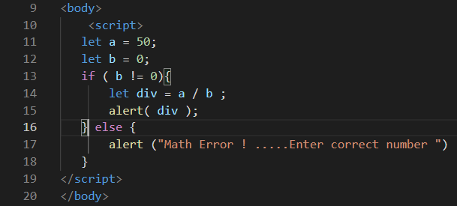
ELSE STATEMENT
Use the else statement to specify a block of code to be executed if the condition is false.
SYNTAX:
if (condition) { // block of code to be executed if the condition is true } else { // block of code to be executed if the condition is false }

Slide 5
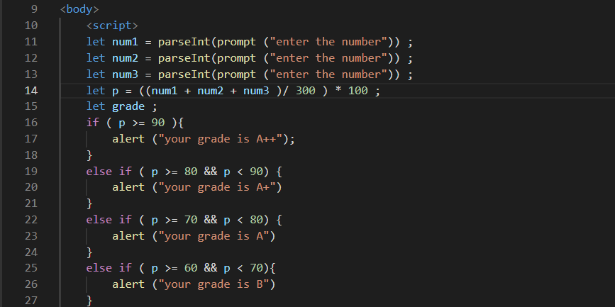
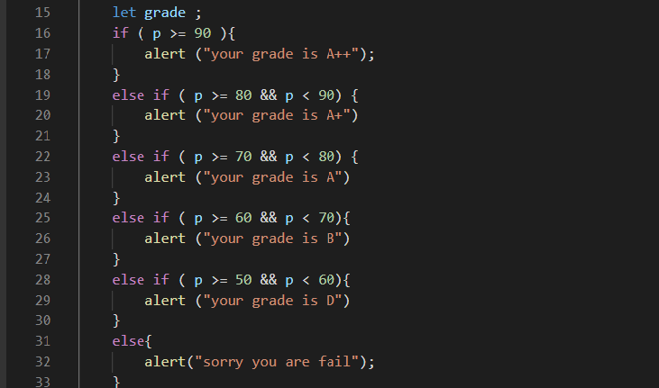
ELSE IF STATEMENT

Slide 6

CONDITIONAL TERNARY OPERATOR
If you have a short if else statement, then you might choose to go with the ternary operator. The word ternary means something composed of three parts.
SYNTAX:
(condition) ? expression on true : expression on false
Example:
let access = age < 18 ? "denied“ : "allowed";
Why use conditional ternary operator instead of if else statement ?
Because it allows us to write concise and clear code .

Slide 7
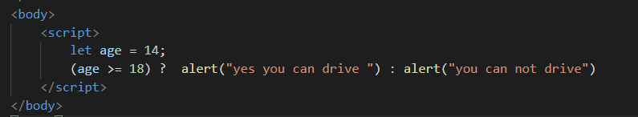
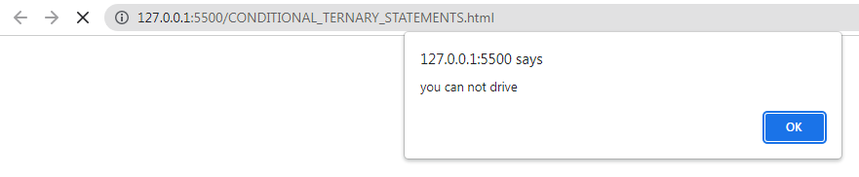
EXAMPLES
EXAMPLE #1
OUTPUT:

Slide 8
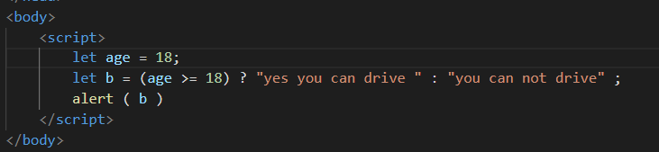
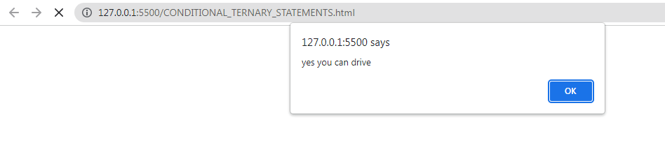
EXAMPLES
EXAMPLE #2
OUTPUT:

Slide 9
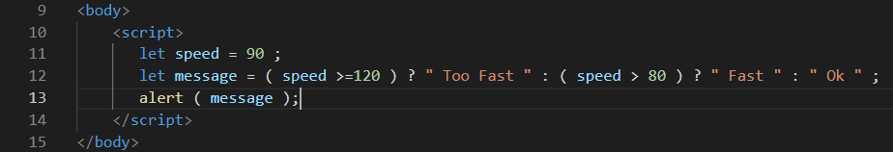
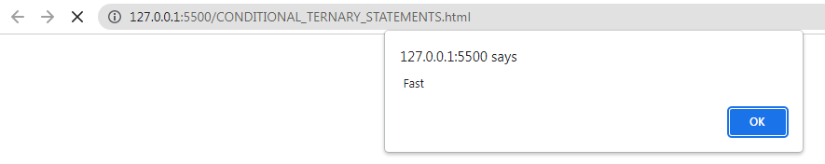
EXAMPLES
EXAMPLE #3
OUTPUT:

